Slide 1

INTERACTIVE DEMO
This is a PowerPoint.
Built in PowerPoint. Uploaded to SoloFire.
Now running as HTML5 in your browser.
Click, tap or press → to continue

Slide 2
CHOOSE A STOP
Every tile on this slide jumps to another slide
Video
Embedded video that plays right on the slide
Go →
Animations
Click-by-click builds, in your order
Go →
Morph
Objects glide from one slide to the next
Go →
Charts
Real chart data, not a screenshot
Go →
…or just keep clicking through in order.
Built in PowerPoint · playing in SoloFire

Slide 3
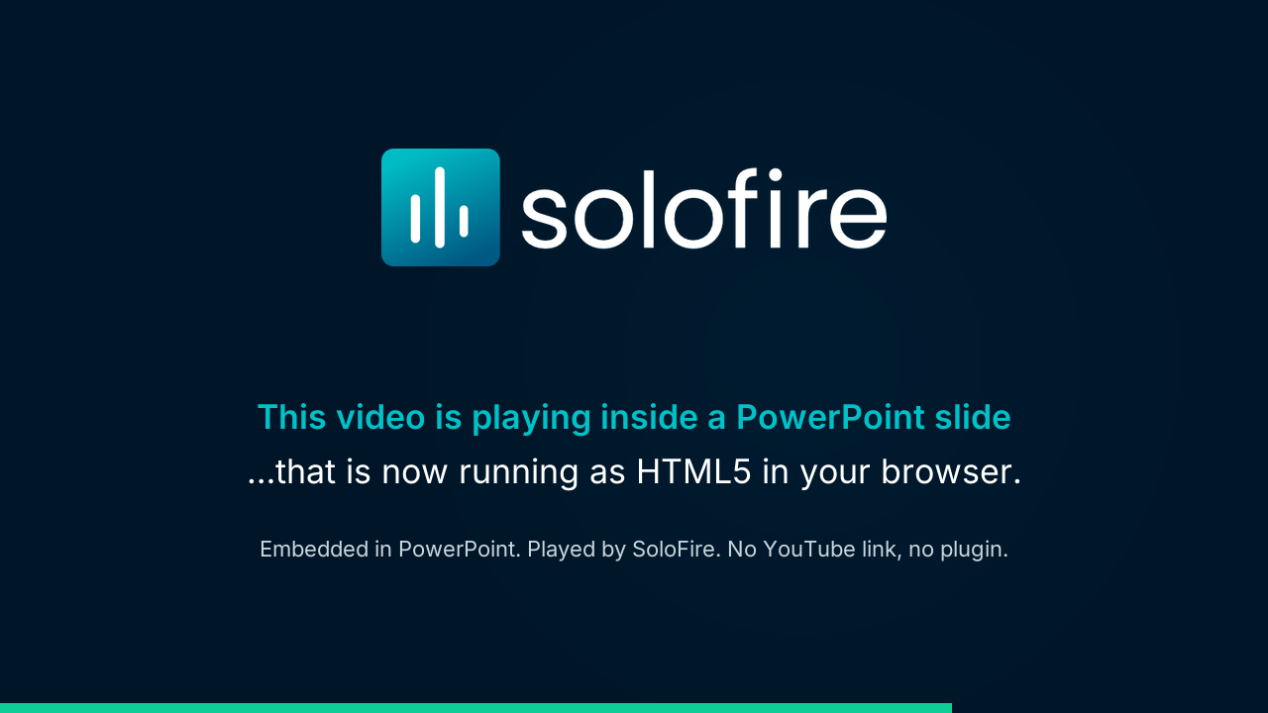
VIDEO
The video lives inside the deck
Press play.
The .mp4 was embedded in PowerPoint the normal way. SoloFire keeps it inside the deck, so it plays right here, with no YouTube link and no plugin.
It plays offline on a rep's iPad too, and in every Space you share.
Built in PowerPoint · playing in SoloFire
← Menu

Slide 4
ANIMATIONS
Click to build this slide
1
Fade in
Click once.
2
Fly in
Click again.
3
Wipe
And once more.
Timing, order and emphasis all survive the upload.
Built in PowerPoint · playing in SoloFire
← Menu

Slide 5
MORPH
Decks on most platforms: a pile of screenshots
Click to morph →
← Menu

Slide 6
MORPH
In SoloFire: every slide, in its place
Slide 1
Slide 2
Slide 3
Slide 4
Slide 5
Slide 6
← Menu

Slide 7
CHARTS
This chart is real data, not a picture
What survives the trip to the web?
Flatten a deck to PDF or images and you keep the layout but lose the rest. SoloFire keeps all four.
The chart itself is drawn from the data inside the .pptx, as crisp vectors that stay sharp at any zoom.
Built in PowerPoint · playing in SoloFire
← Menu

Slide 8
Everything you just clicked was a .pptx.
Upload your decks to SoloFire and they play like this: on every device, online or off, and in every Space you share.
Book a demo →
Download this .pptx
← Menu

